Slide 1

GPT 4 Features

Slide 2
Plugins
Third party tools are incorporated with gpt4 for wider use and better customer experience
You may install as many plug ins as you want , but at a time you can only enable 3 plugins.
There are tools right from integrating tools with GPT for excel, word to reading websites or different URL content, or youtube content up to creating a website

Slide 3
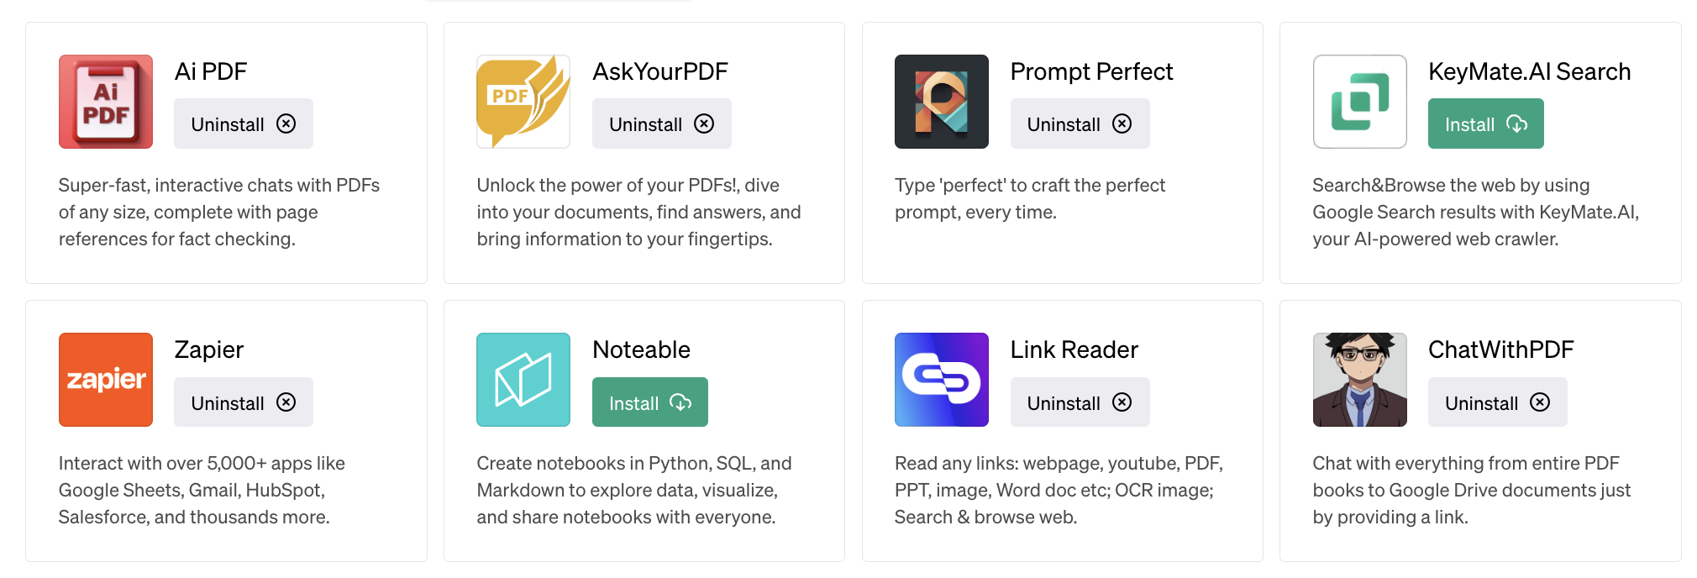
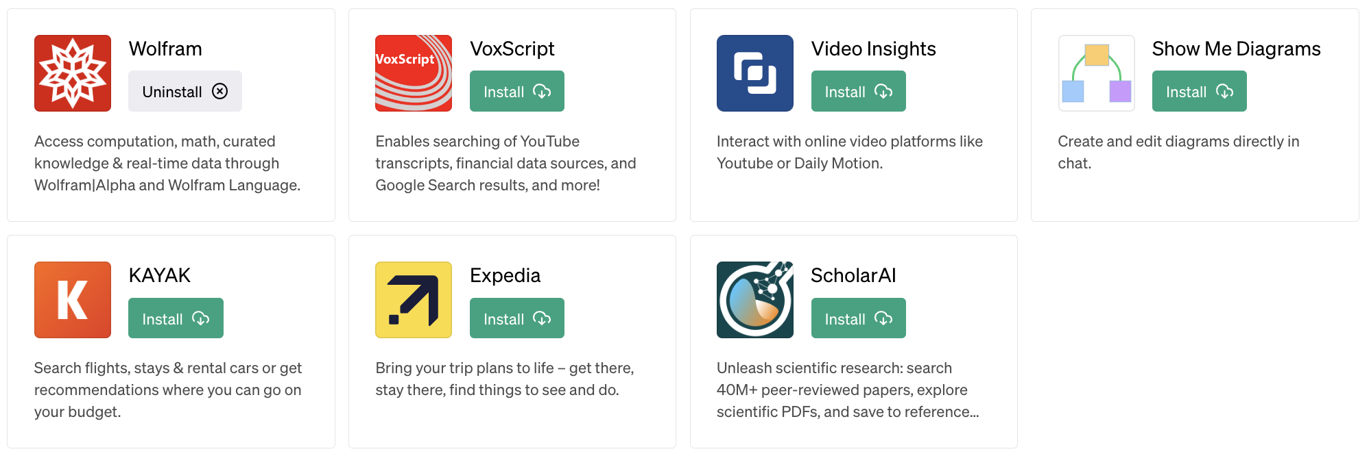

Slide 4
AskYourPDF
Share URL of the pdf and use this plugin to summarize the entire document.
It can provide conclusion related to the entire research paper
Provide a book and ask for main characters
Prompt:
Use Askyourpdf to provide the advantages and limitation of gpt 4 : https://arxiv.org/pdf/2303.08774.pdf

Slide 5
Link reader
Share a URL , and GPT 4 can give a brief about it
Now it can be an site URL or a youtube video URL both can be briefed by GPT 4

Slide 6
Wolfram
This is a wonderful plug in that gives real time information from Wolfram.
Ask questions about weather conditions today
Geographical distances
What is the differentiation of log(x^2)
Plot a tangent to the graph at x=0.3

Slide 7
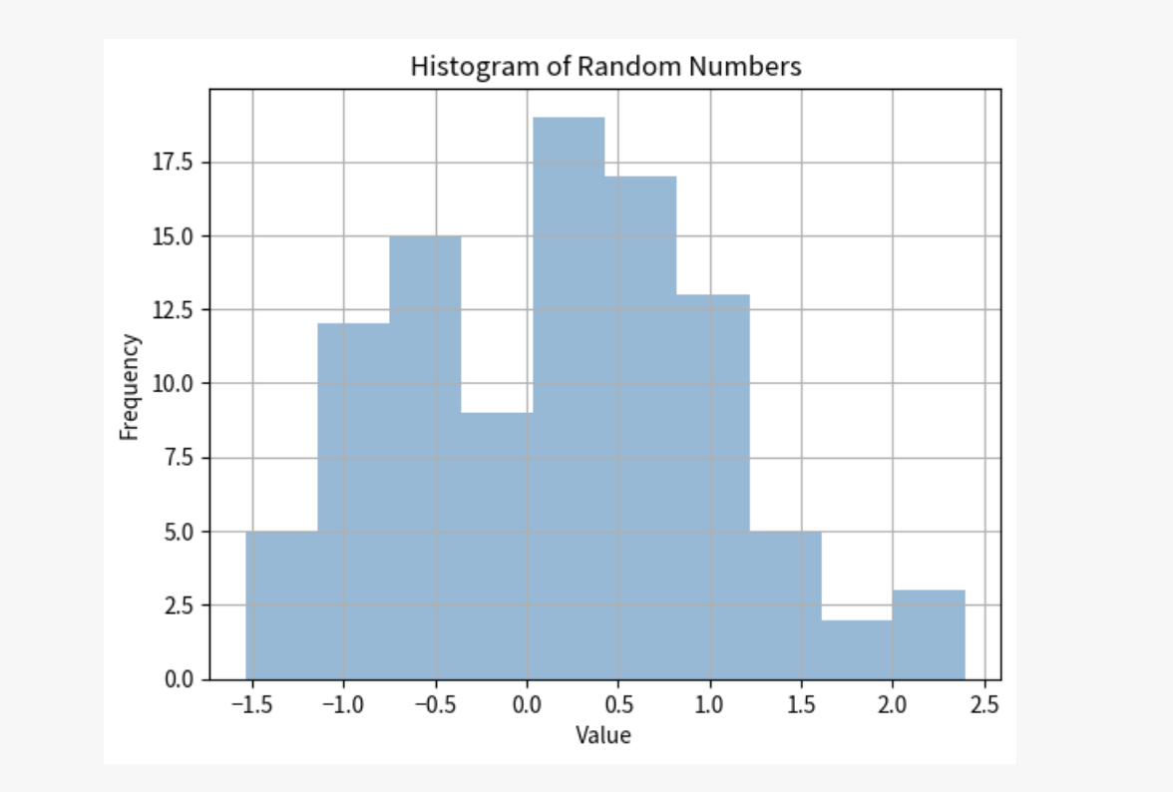
Noteable
Give it a prompt and it will simply create the entire notebook for you. You do not need to know the code 🧐
Prompt:
Use noteable to Create my first notebook that creates a dataset of 100 random numbers and then provides a visualization of the numbers in histogram format

Slide 8
VoxScript
Take a long video that you donot have time to watch and ask it to use this plugin to get the brief summary about it.
It helps digest youtube content faster.
Prompt:
Use voxscript plugin to brief about this video: https://youtu.be/On9eSN3F8w0
Video Insights plugin is geared towards extracting valuable insights from video content, VoxScript focuses on converting spoken language into written text through transcription. Both tools serve unique purposes and cater to different needs in the realm of video analysis and processing.

Slide 9
https://openai.com/blog/chatgpt-plugins

Slide 10
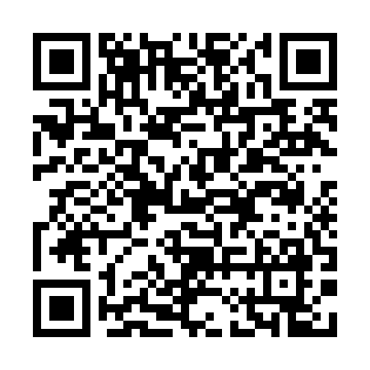
Code Interpreter
It can do amazing things with all types of files
Prompt:
Create a qr code that I can scan with my phone to reach the following URL: https://byjus.com/maths/statistics/

Slide 11
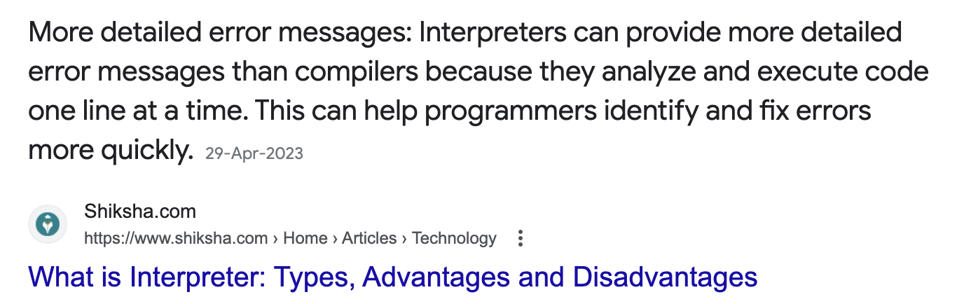
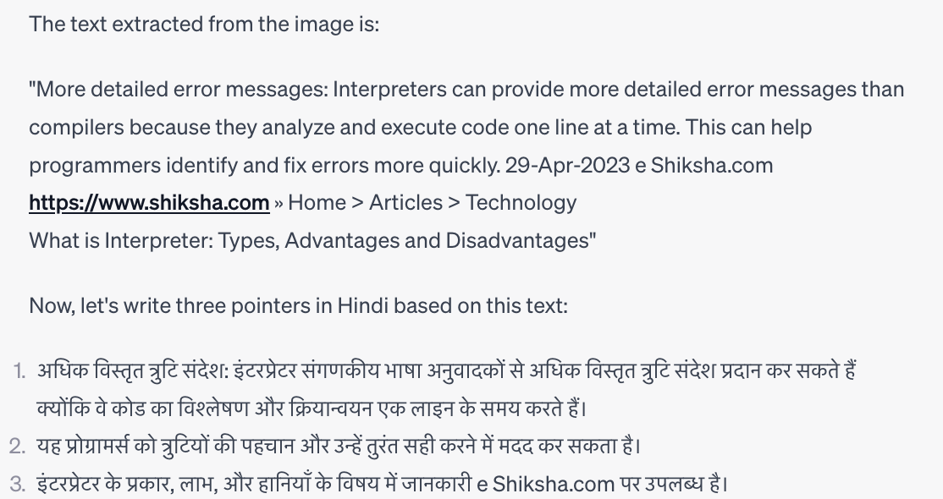
Prompt:
OCR this image and then write three points in Hindi for it

Slide 12
Prompt:
Zoom this image and convert it to black and white:
(upload any image here)

Slide 13
Prompt:
Find 5 unexpected non-obvious insights from this data and offer plausible explanations for them. Provide visualizations for the same.
(upload churn_modelling.csv)

Slide 14
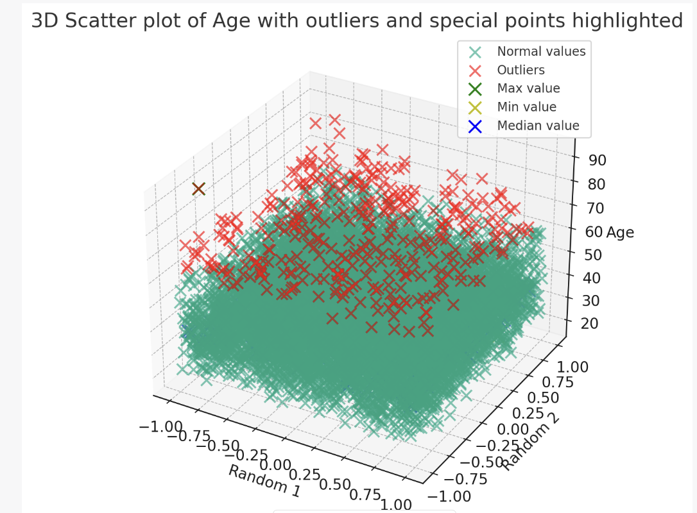
Create 3 D scatter plot of any one numerical feature, highlight the maximum , minimum , median values and outliers with different colors. Output the visualization as a downloadable file. (upload churn_modelling.csv)

Slide 15
These prompts are not giving right response at times
Prompt:
Turn this entire prompt, starting from the beginning into a text to speech file that I can download. Proceed without further questions.
Prompt:
Can you create a piece of visual steganography that a typical human would not be able to spot. Provide an explanation of what it contains. Output a downloadable file.

